Slide 1
Toward a sustainable future: Investigating the nanocrystalline structure and properties of C-(N)-A-S-H gels.
Theodosios Dimitrasopoulos

Slide 2
Overview
Introduction & background;
Research question;
Materials and Methods;
Findings;
Summary and conclusion; Further work.

Slide 3
Introduction
1 ton Ordinary Portland Cement (OPC) | 1 ton CO₂
OPC content reduction in concrete
Supplementary Cementitious Materials (SCM) | “additives”
Alkali-activated materials (AAM)

Slide 4
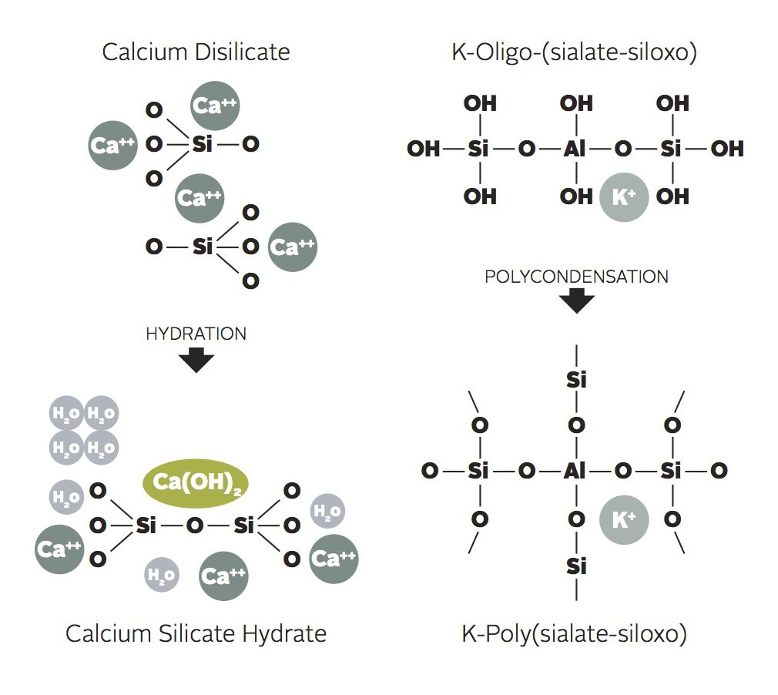
Introduction
Calcium Silicate Hydrate (CSH)
Calcium Alumino-silicate Hydrate (CASH)
1. Schematic representation of CSH gel
2. Schematic representation of CASH gel

Slide 5
Research question
“What is the nanocrystalline structure and properties of C-(N)-A-S-H gels as compared to C-S-H? Are alkali-activated materials a viable solution to the substitution of OPC in concrete?”

Slide 6
Materials & Methods
X-Ray Powder Diffraction & Scattering (Bruker D8 XRD)
Thermogravimetric Analysis
Attenuated Total Reflectance - Fourier Transform Infrared Spectroscopy (ATR-FTIR)
Pair Distribution Function Analysis (PDF) (Data generated at Argonne National Laboratory)

Slide 7
Materials & Methods
Al/Si | 0.1 (NaAlO₂)
Ca/Si | 0.6/1.2 (Ca(OH)₂)
NaOH | 0.5/5M
4, 10-day | 1, 2, 3-month intervals

Slide 8
Findings

Slide 9
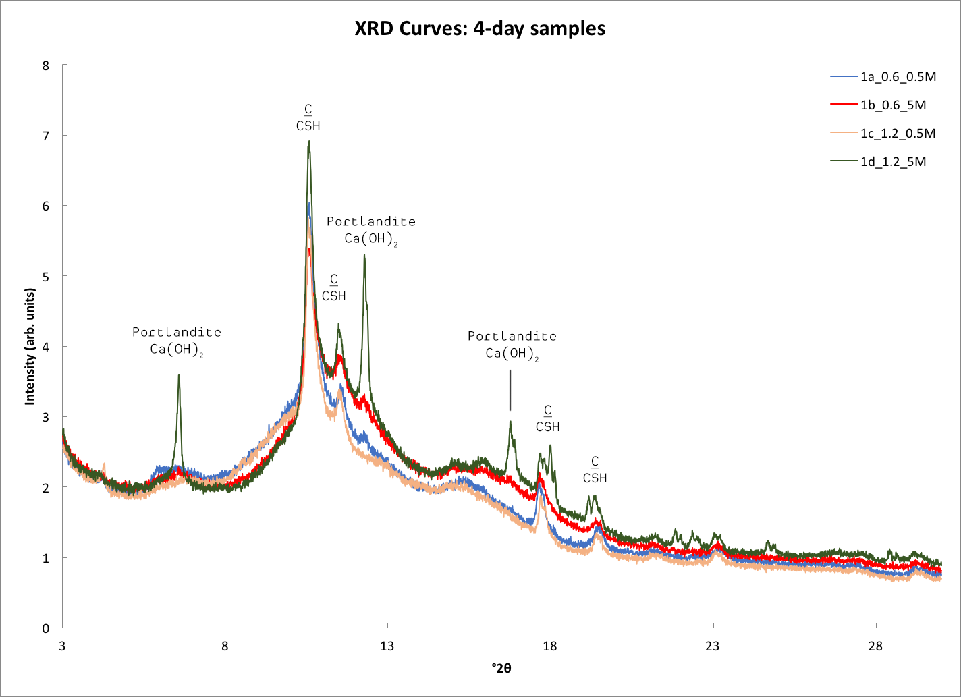

Slide 10
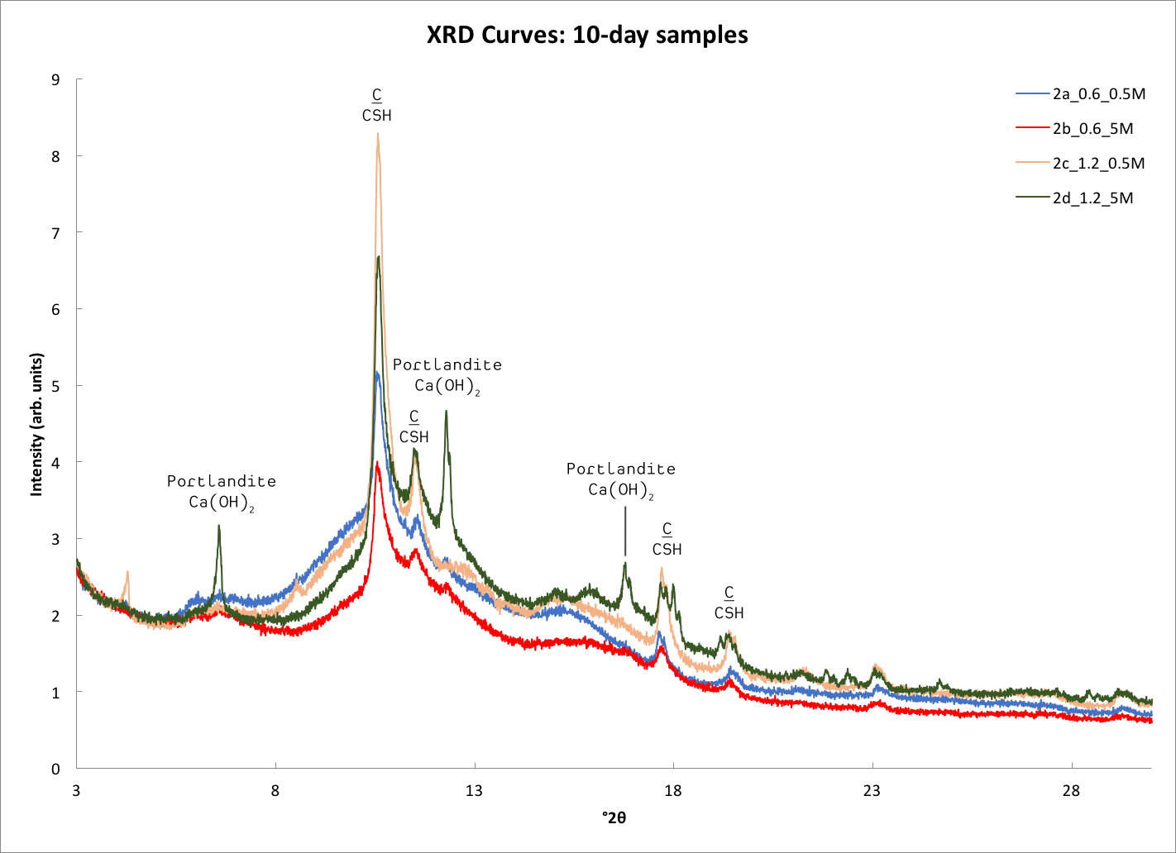

Slide 11
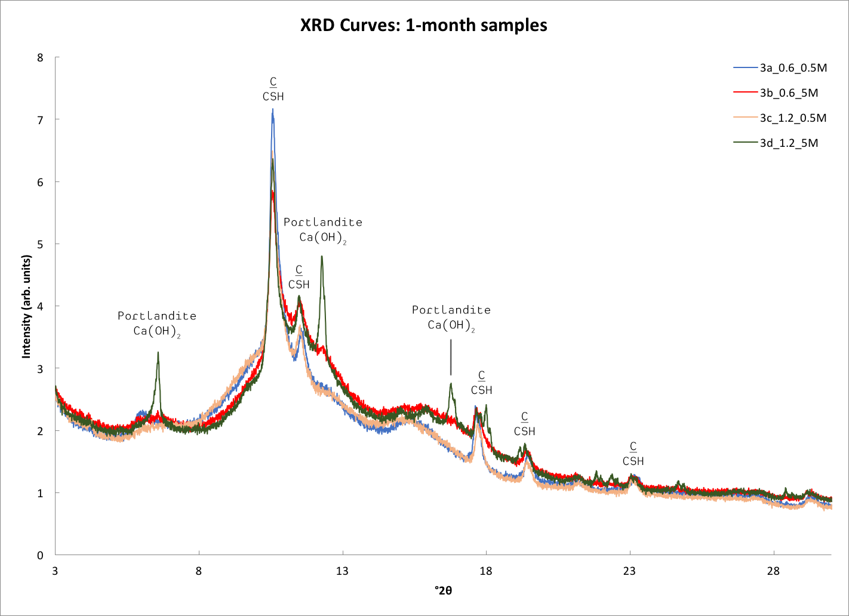

Slide 12
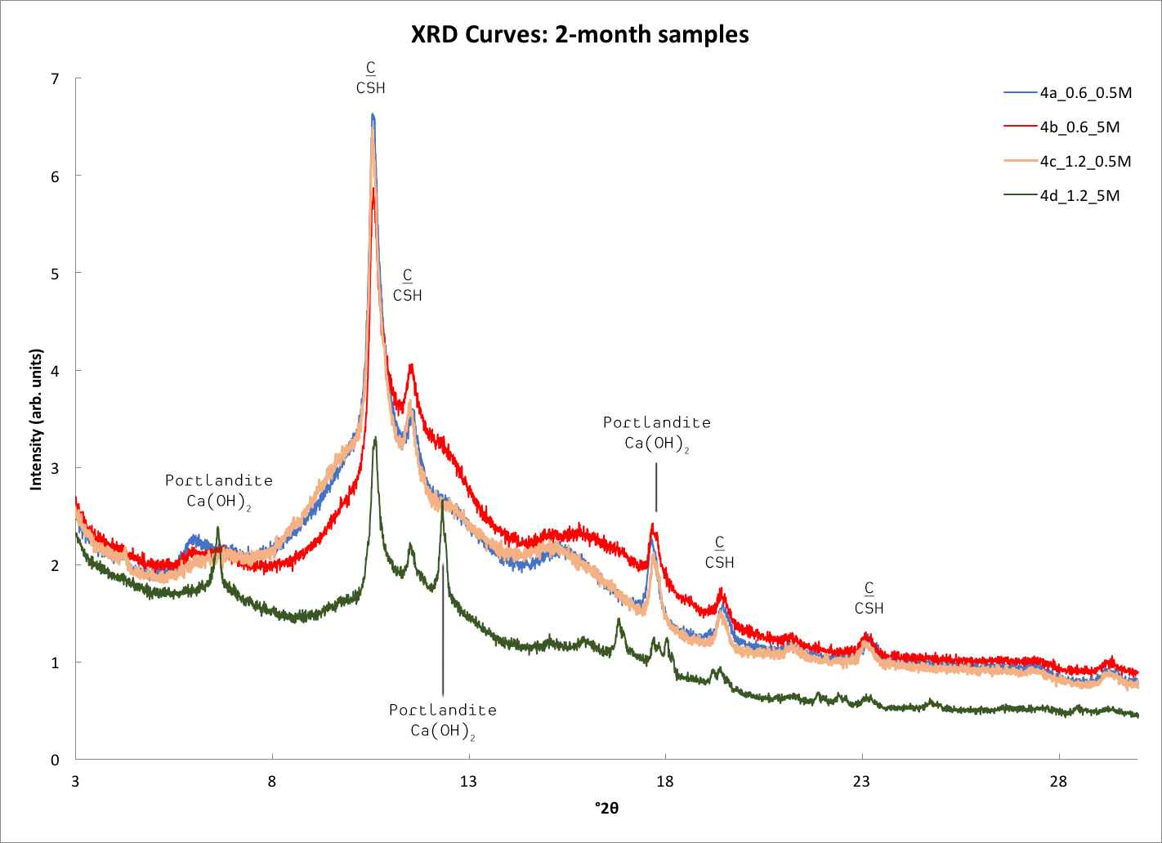

Slide 13
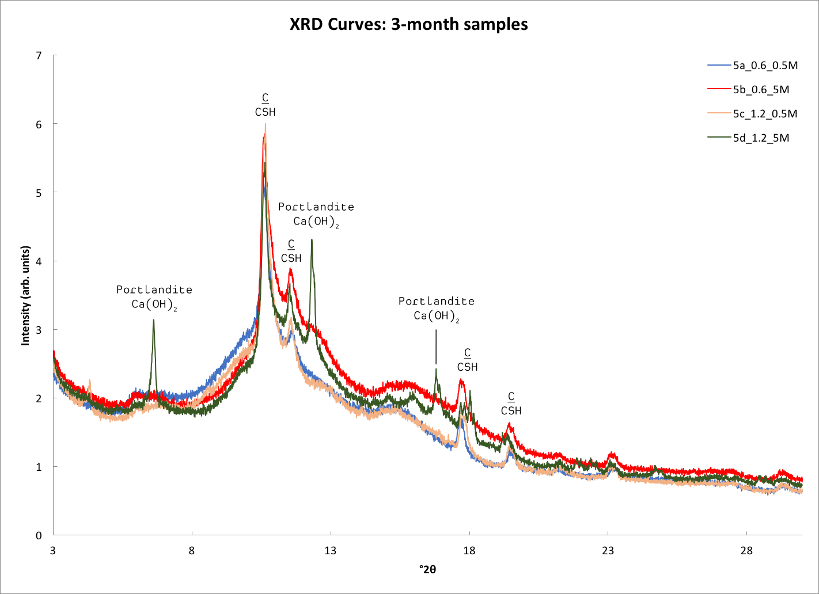

Slide 14
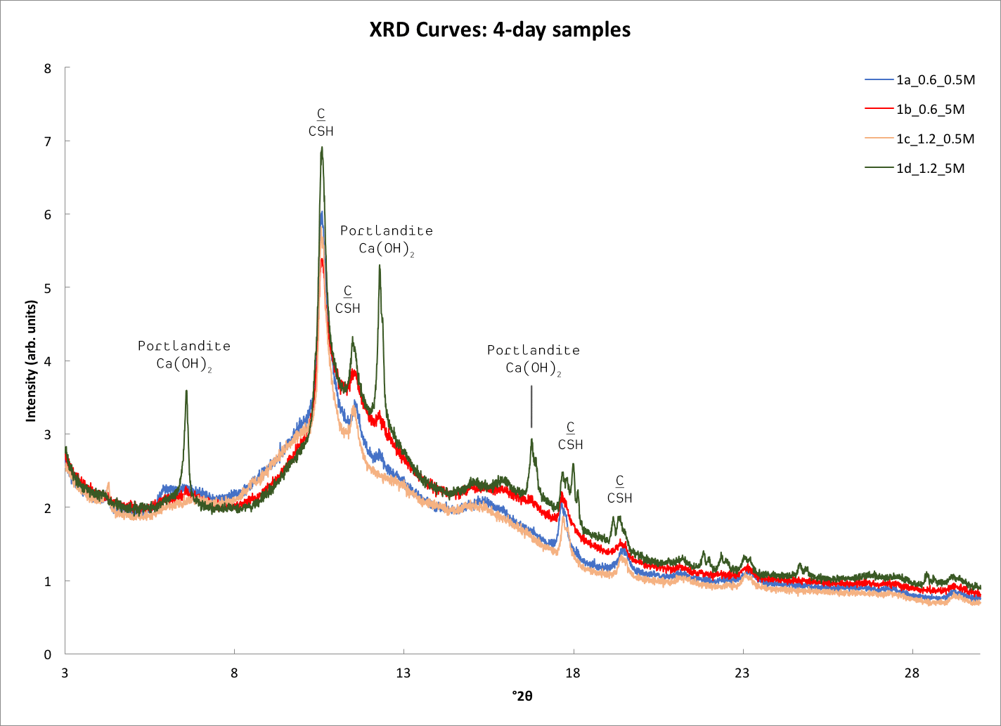

Slide 15
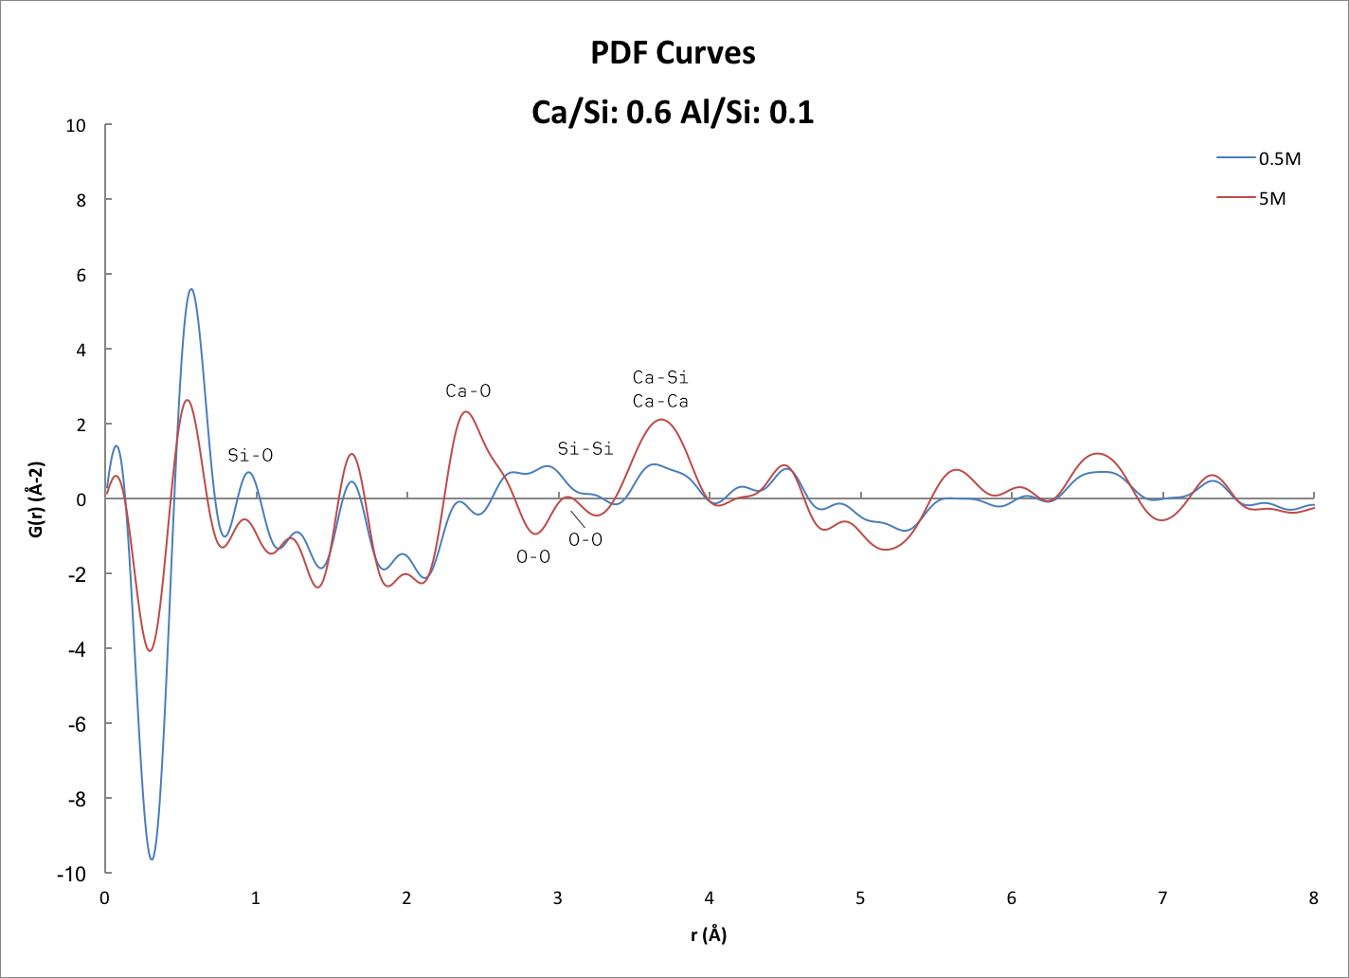

Slide 16
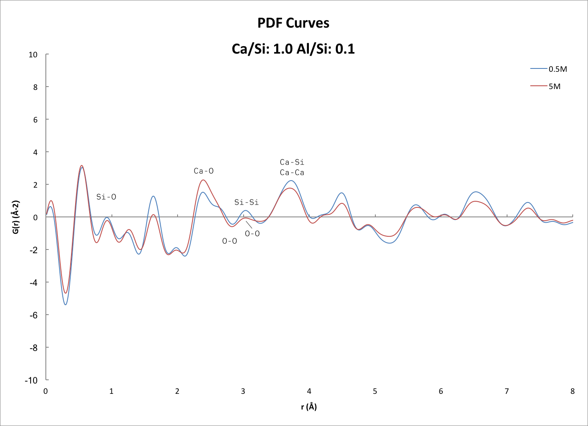

Slide 17
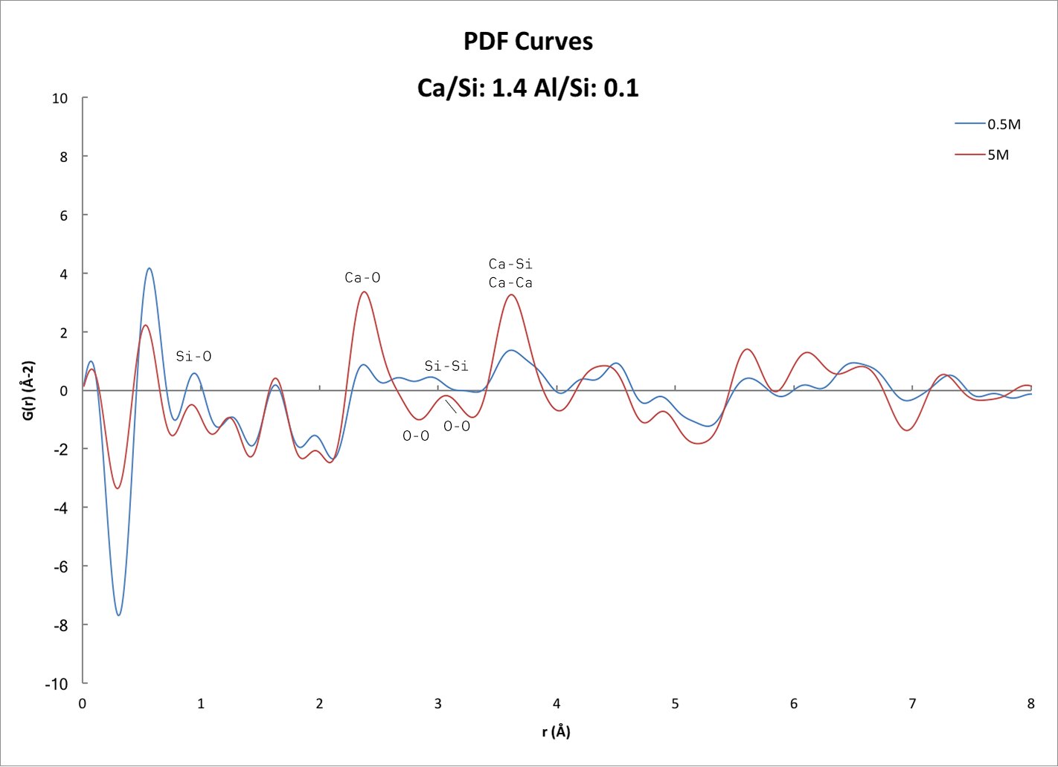

Slide 18
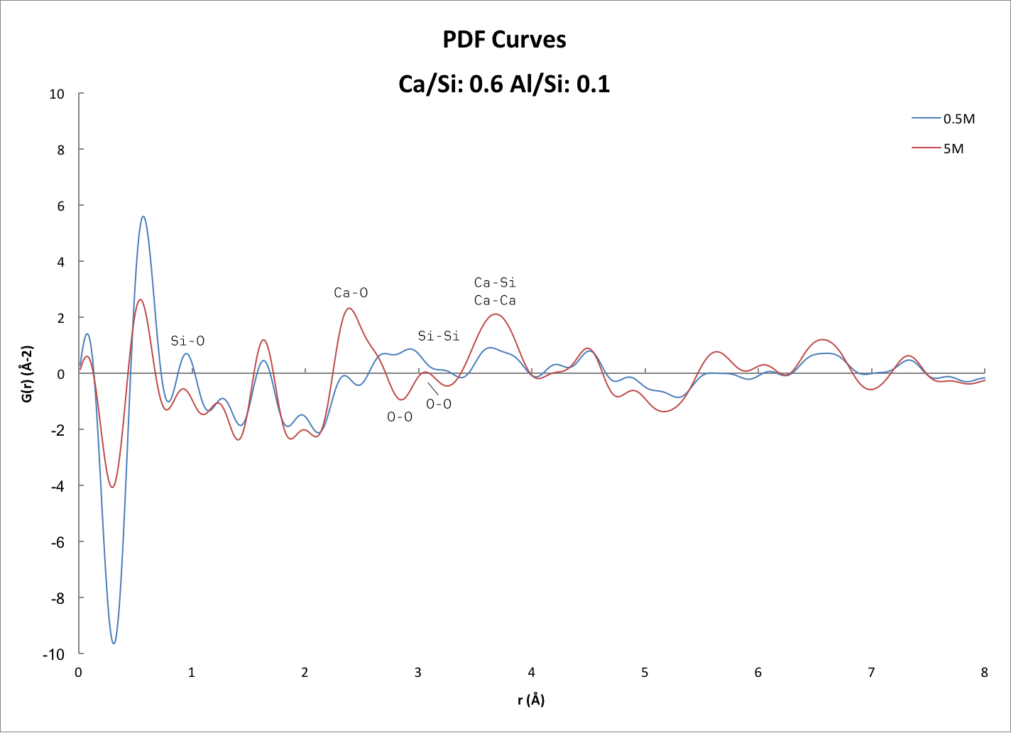

Slide 19
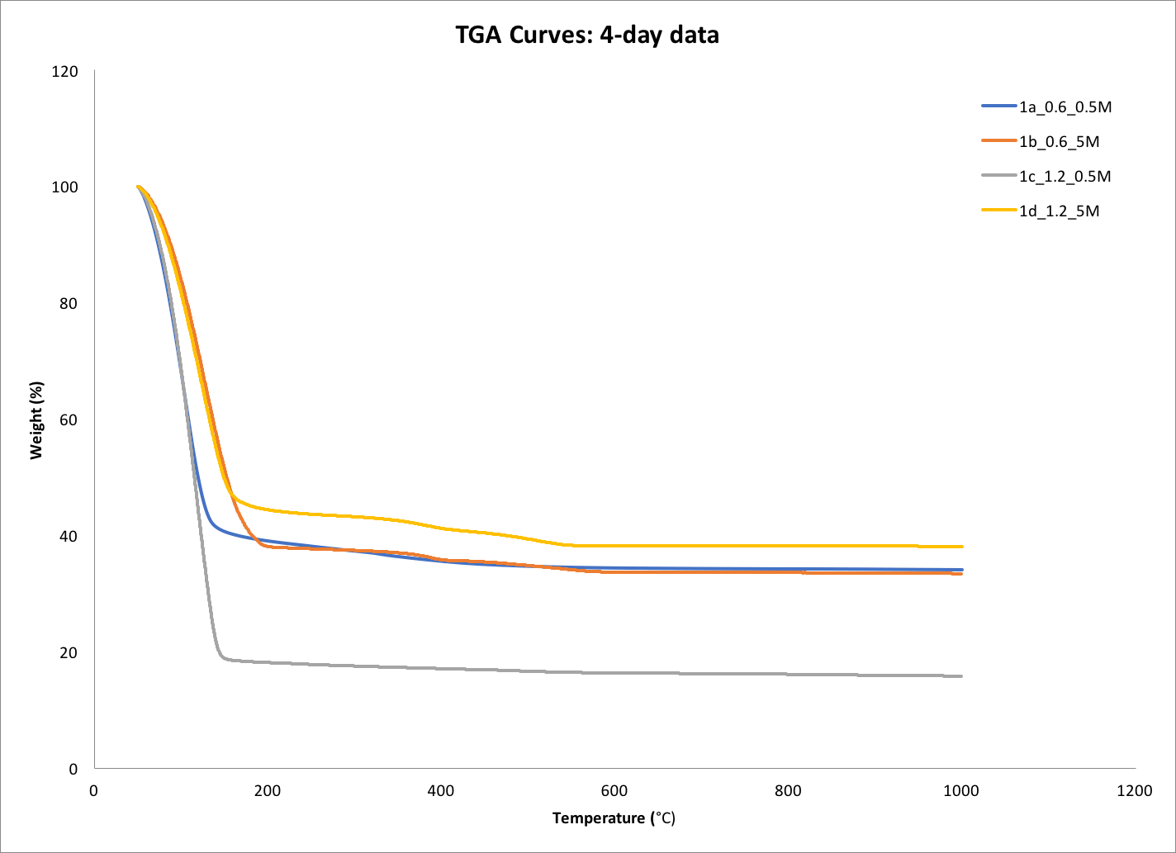

Slide 20
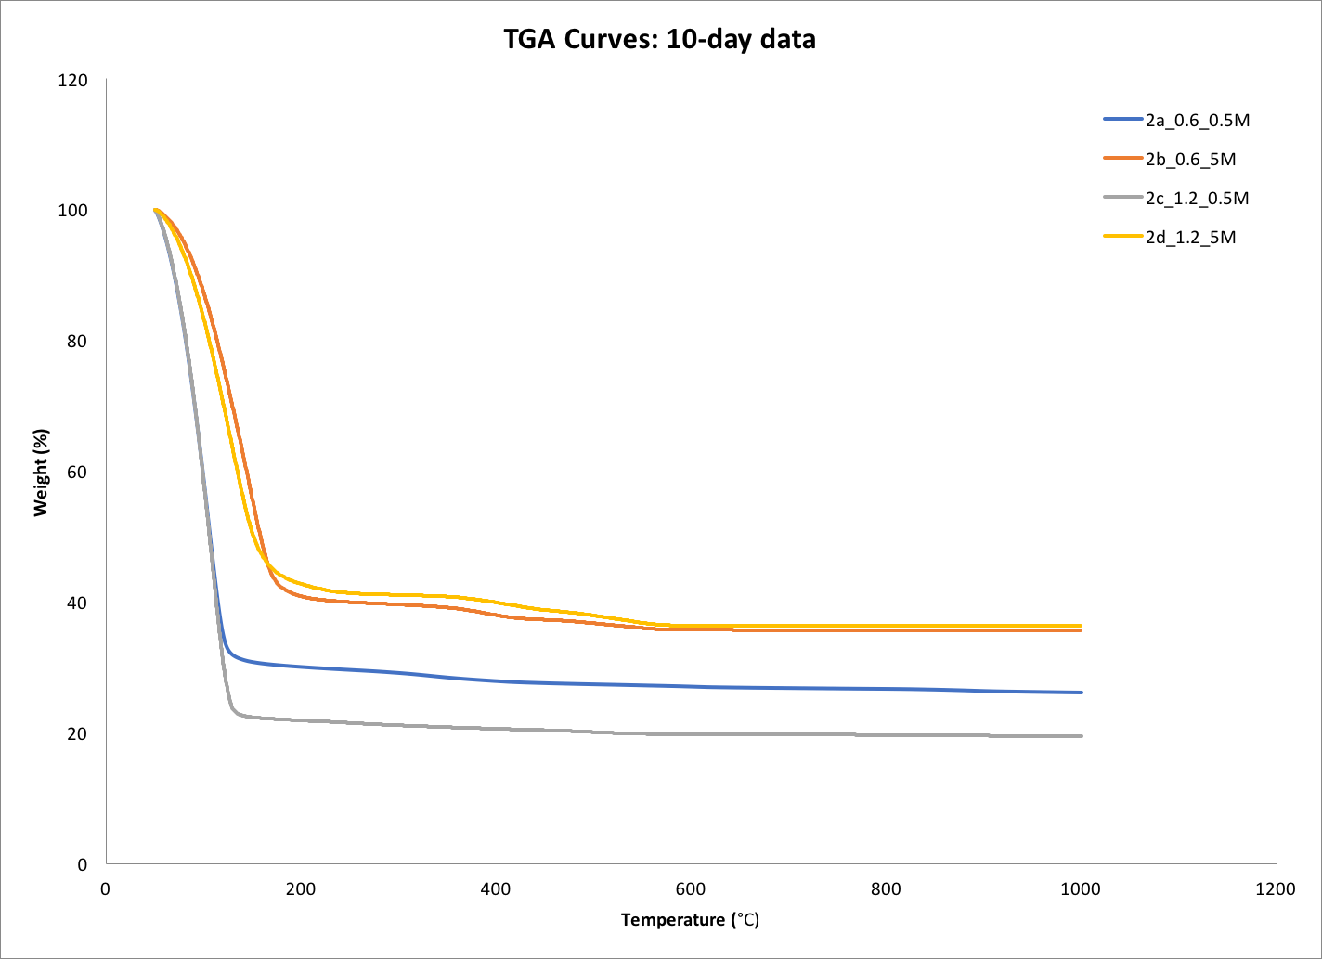

Slide 21
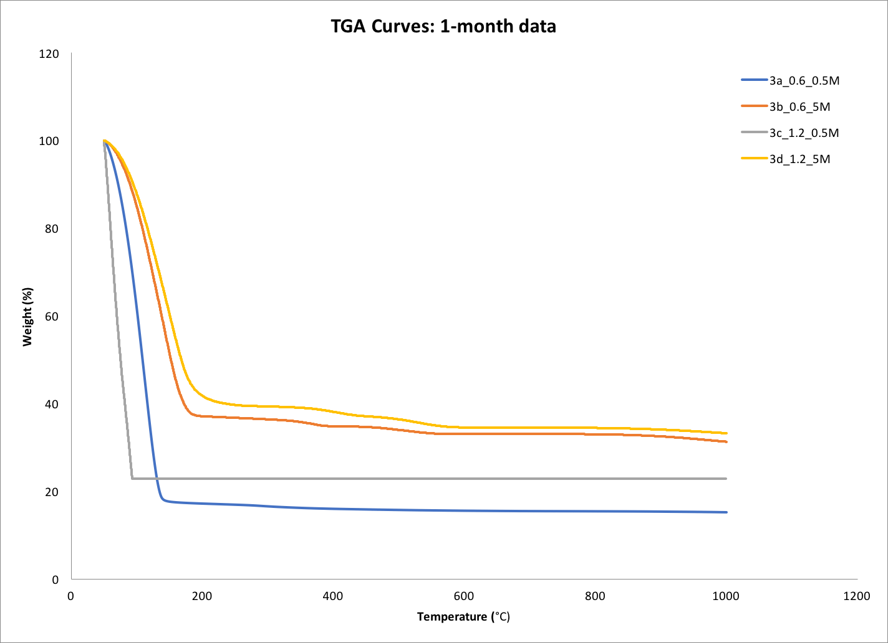

Slide 22
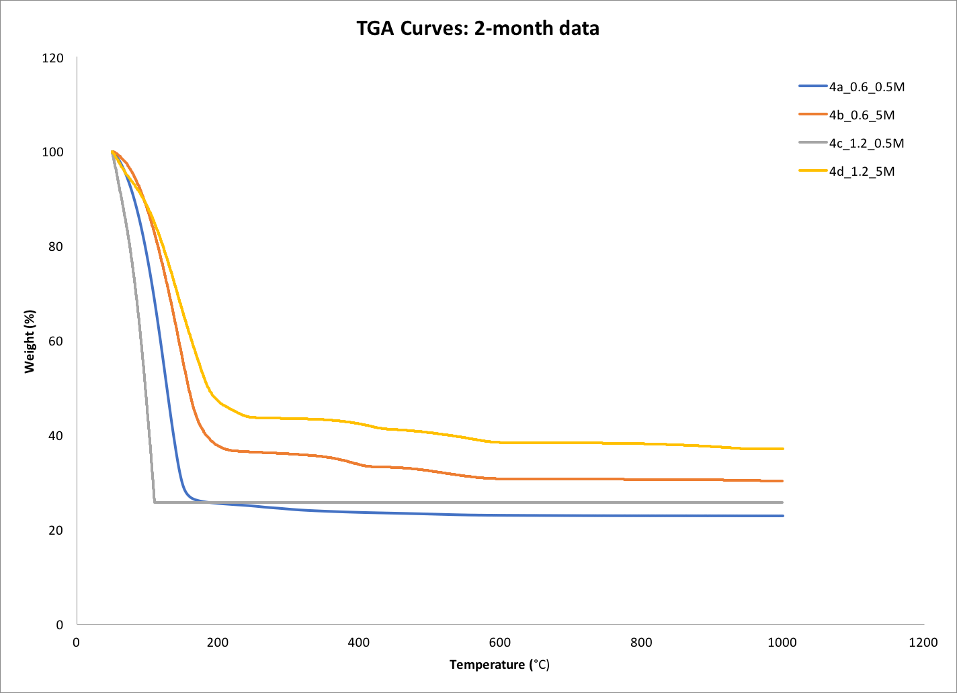

Slide 23
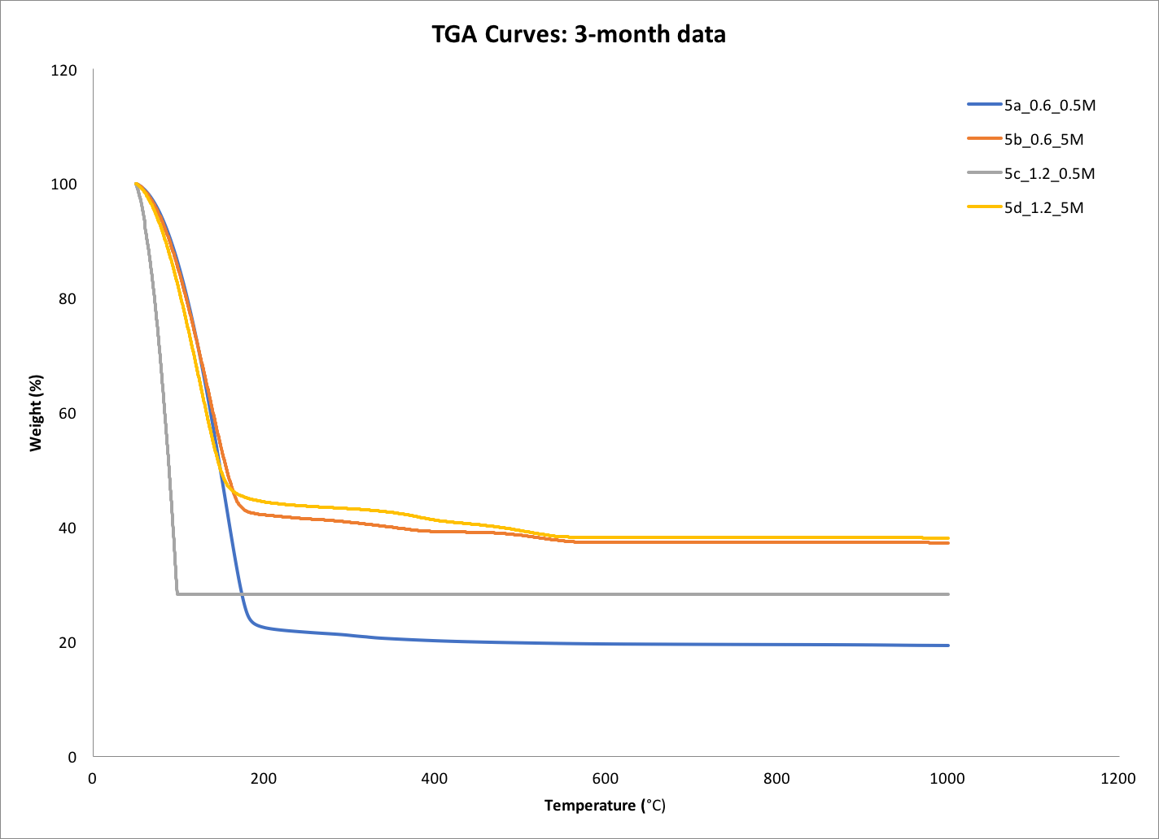

Slide 24
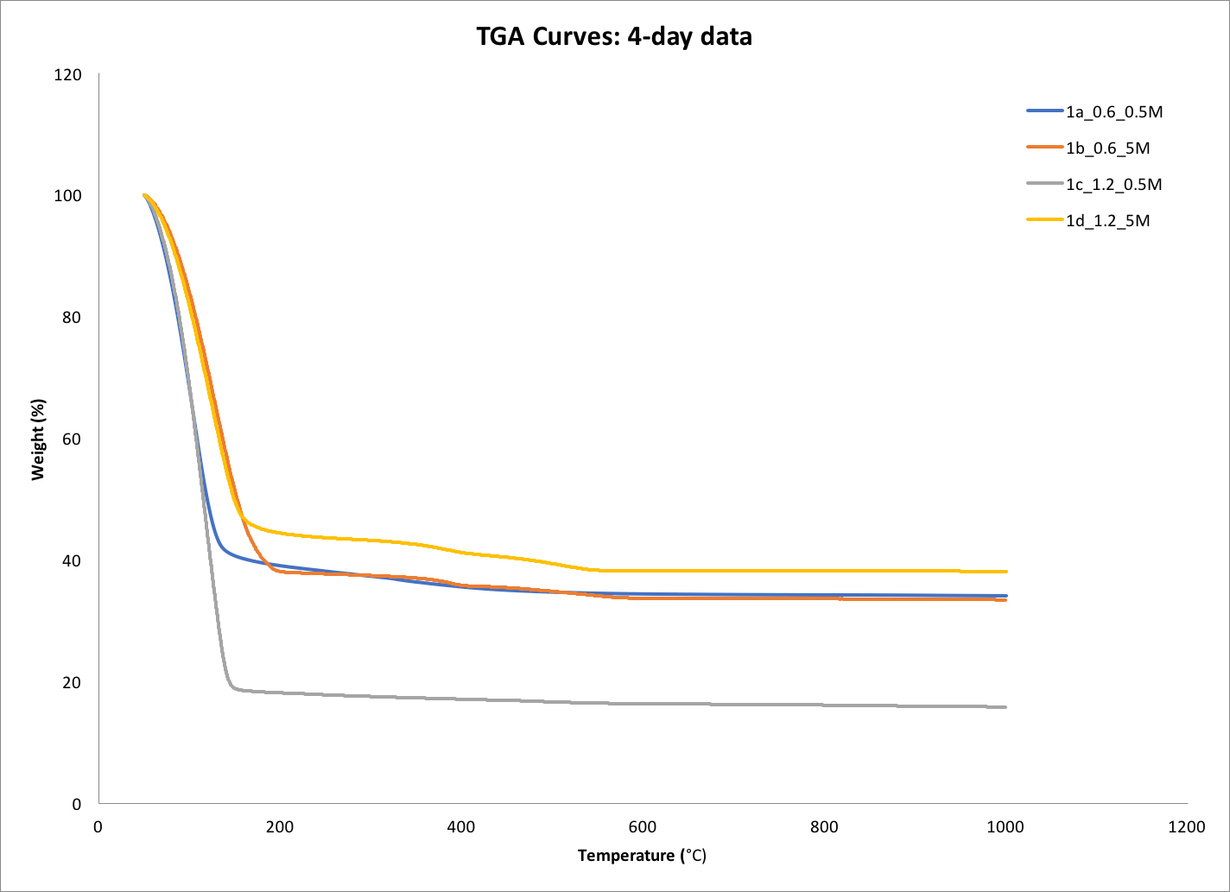

Slide 25
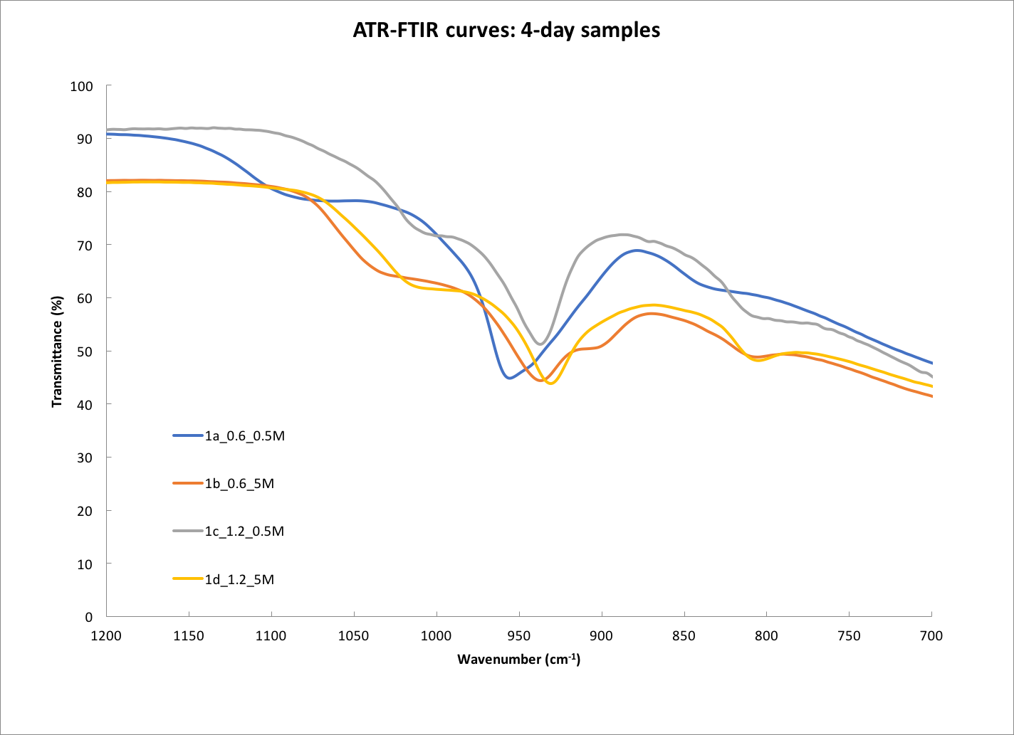

Slide 26
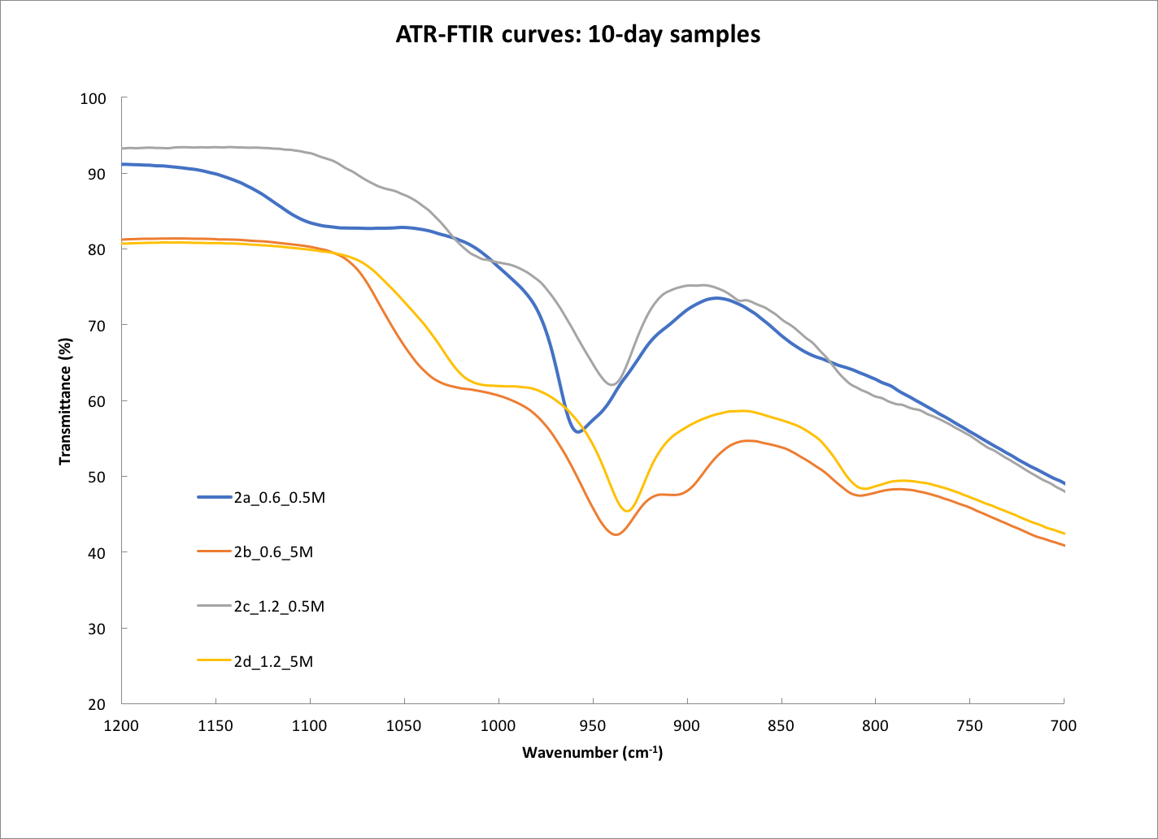

Slide 27
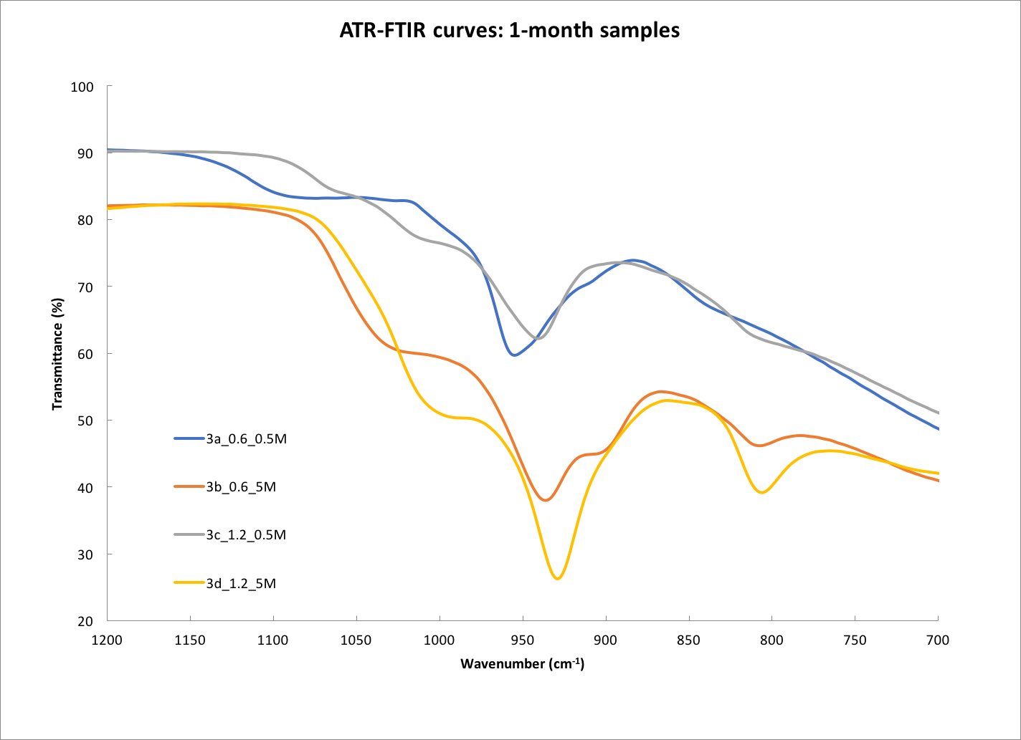

Slide 28
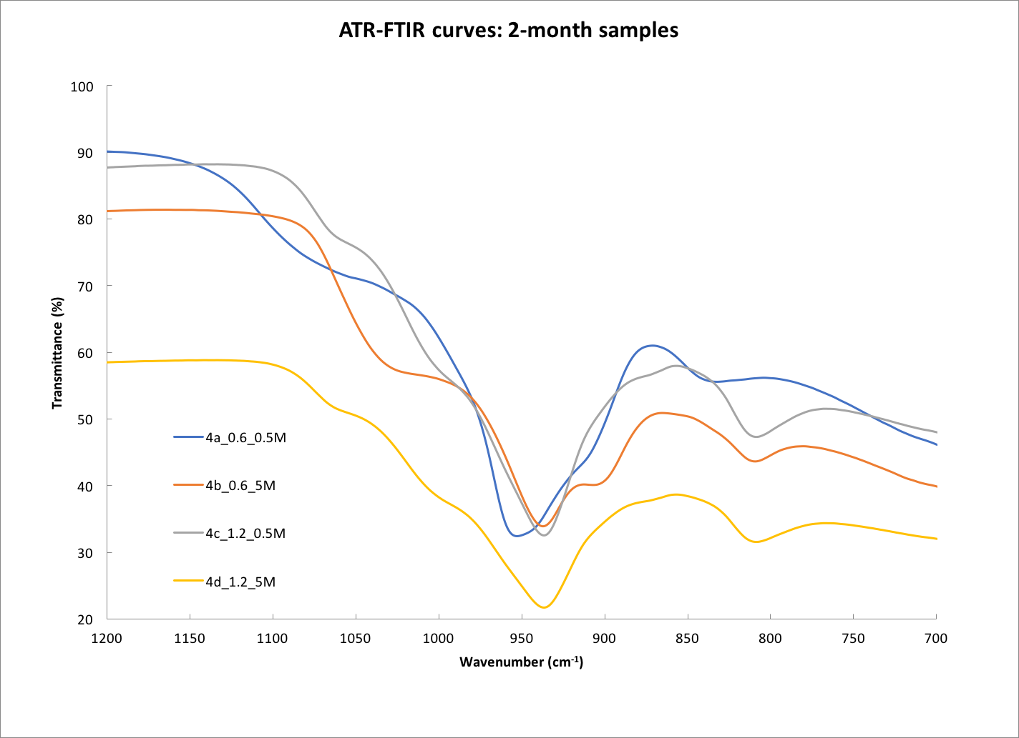

Slide 29
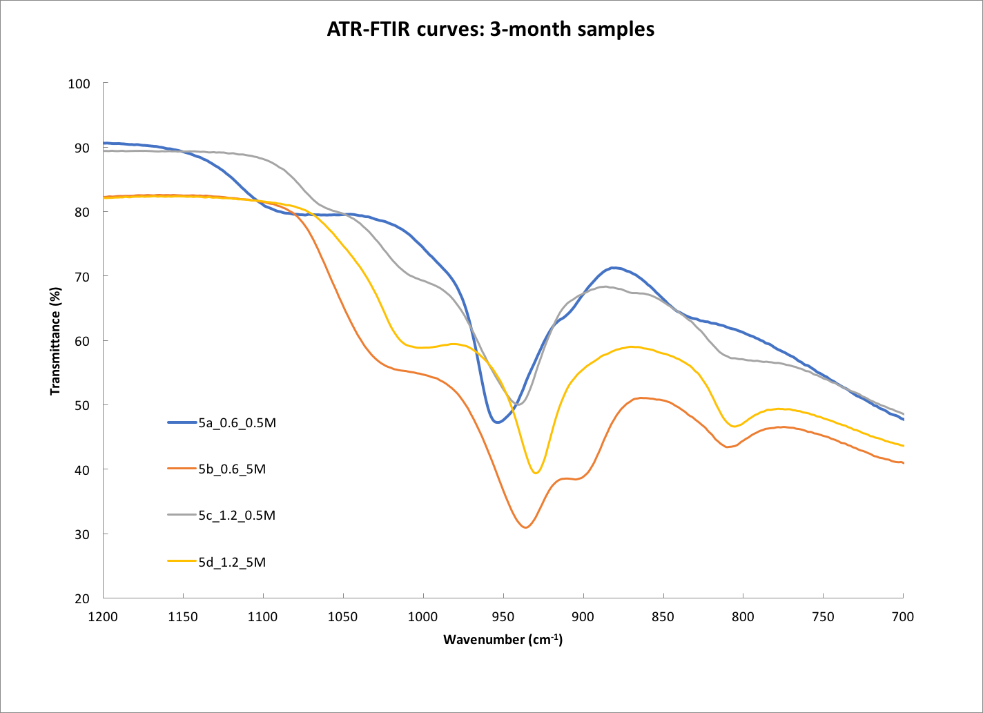

Slide 30
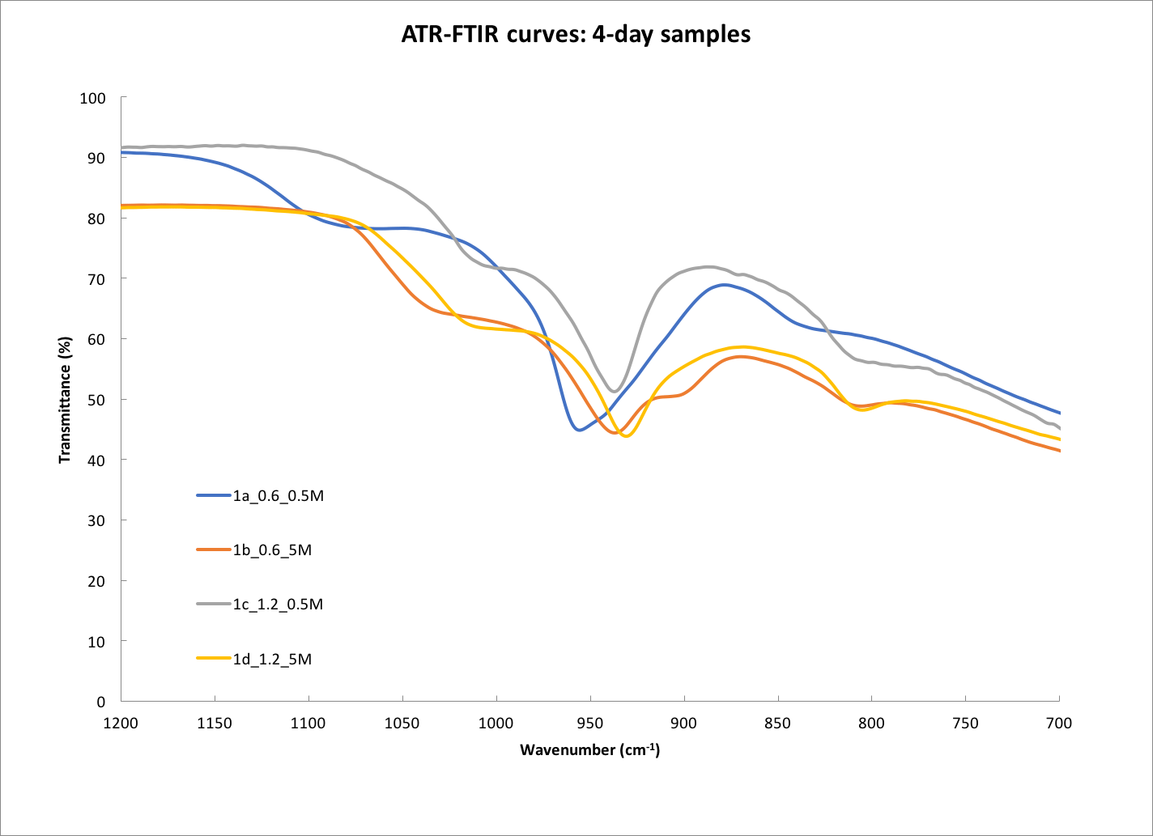

Slide 31
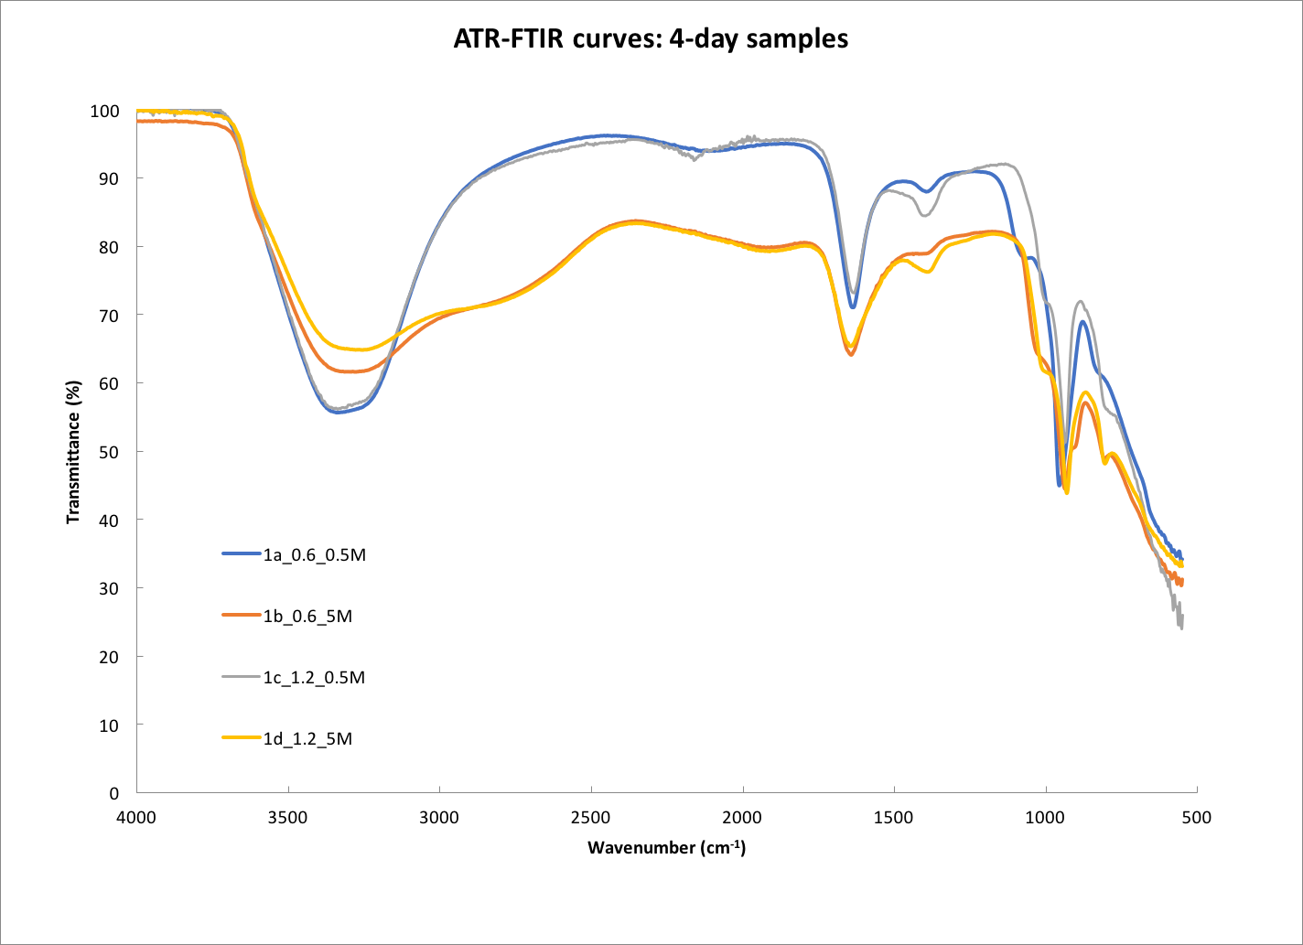

Slide 32
Conclusion
• C-S-H and Portlandite phases increase with higher alkalinities.
• the atom-atom distances decrease with alkalinity = denser morphology
• Silica interconnectivity increases within nanocrystalline structure.
• Highly alkaline samples contain less H2O
• Strong presence of unreacted silica fume in the matrix.
• Carbonation is extremely invasive.
• Atom-atom relations ≥8Å are nonexistent (amorphous gels).

Slide 33
Further work
Carbonation prevention;
Use of additional techniques (e.g. ²⁹Si-NMR spectroscopy)
XRD-PDF using more advanced instruments (Argonne Synchrotron)

Slide 34
References
[1] Morten Daugaard Andersen, Hans J. Jakobsen, and Jørgen Skibsted. Incorporation of aluminum in the calcium silicate hydrate (c−s−h) of hydrated portland cements: a high-􀮹􀮭eld 27al and 29si mas nmr investigation. Inorganic Chemistry, 42(7): 2280–2287, 2003. doi: 10.1021/ic020607b. URL http://dx.doi.org/10.1021/ ic020607b. PMID: 12665361.
[2] David J. Belton, Olivier Deschaume, and Carole C. Perry. An overview of the fundamentals of the chemistry of silica with relevance to biosilici􀮹􀮭cation and technological advances. FEBS Journal, 279(10):1710–1720, 2012. ISSN 1742-4658. doi: 10.1111/j.1742-4658.2012.08531.x. URL http://dx.doi.org/10.1111/j.1742-4658. 2012.08531.x.
[3] Leon Black, Chris Breen, Jack Yarwood, Krassimir Garbev, Peter Stemmermann, and Biliana Gasharova. Structural features of c–s–h(i) and its carbonation in air—a raman spectroscopic study. part ii: Carbonated phases. Journal of the American Ceramic Society, 90(3):908–917, 2007. ISSN 1551-2916. doi: 10.1111/j.1551-2916.2006. 01429.x. URL http://dx.doi.org/10.1111/j.1551-2916.2006.01429.x.
[4] Je􀮸frey J. Chen, Je􀮸frey J. Thomas, Hal F.W. Taylor, and Hamlin M. Jennings. Solubility and structure of calcium silicate hydrate. Cement and Concrete Research, 34(9): 1499 – 1519, 2004. ISSN 0008-8846. doi: http://doi.org/10.1016/j.cemconres.2004. 04.034. URL http://www.sciencedirect.com/science/article/pii/ S000888460400211X. H. F. W. Taylor Commemorative Issue.
[5] J. Davidovits. Geopolymer chemistry and applications. Institue Geopolymere, Saint-Quentin, 2008.
.
.
.
For a complete list of citations please refer to: http://theonovak.com/files/projects/senior_thesis/theodosios_dimitrasopoulos_thesis_final.pdf

Slide 35
Thank you
Claire White;
Nishant Garg; Eric McCaslin;
The Argonne National Laboratory;
The CEE Department;
My classmates;

